Slide 1
This Week Work Progress
Lecturer：SUSTech Li Yuchen
2019.3.07

Slide 2
content
01
Reading Code & Recurring paper
02
Mis-Classification analysis
03
Studying machine learning & Tensorflow

Slide 3
Reading paper & Recurring paper
Part One
01

Slide 4
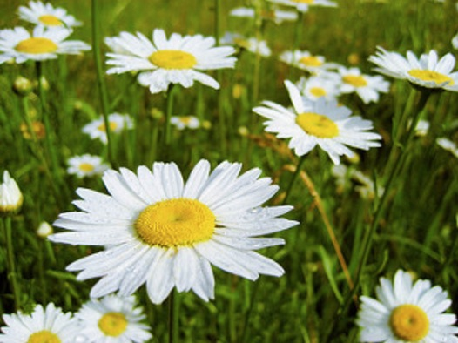
Kaggle-Diabetic Retinopathy Detection

Slide 5
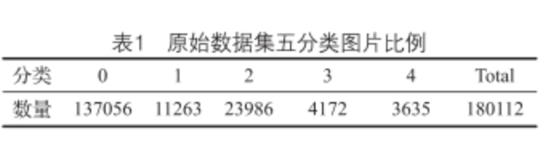
Diabetic Retinopathy Detection
0 - No DR 1 - Mild 2 - Moderate 3 - Severe 4 - Proliferative DR

Slide 6
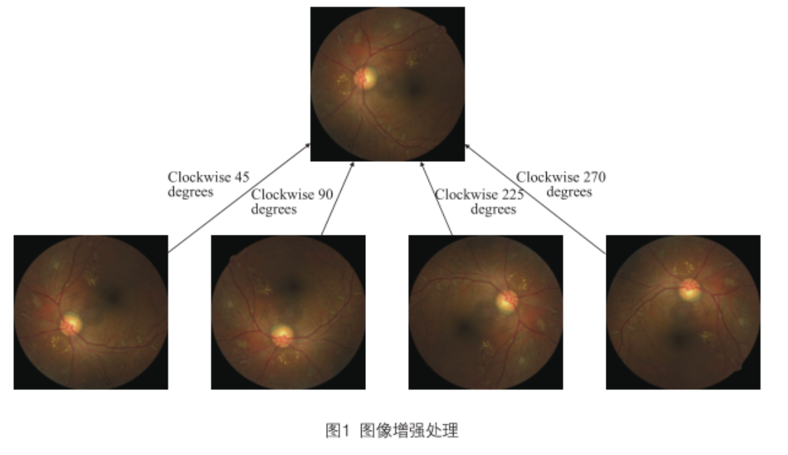
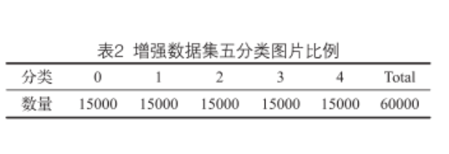
Paper Artificial Intelligence of Diabetic Retinopathy Image Recognition Used in the Real World
数据不均衡的解决方案：
0类数据占绝对优势，如不添加预处理，0类将表现极高的特异性（specificity）和敏感性（sensitivity），其他类别分类准确性也会收到影响。
- Resolution：
1、Due to the bad quality of some images(such as Underexposed, Light leakage) remove the bad quality images
2、Choose the high quality images of category 0 and 2, respectively 15000 images.
Others do rotation.

Slide 7
CNN
-五分类
ResNeXt 50:77.02%
Inception-V3:76.76%
双眼融合SVM和Inception V3：82.54%
二分类
·双眼融合SVM和Inception V3：92.62%
Sensitivity：95.3%
Specificity：79.5%

Slide 8
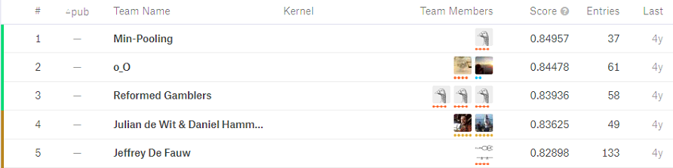
Opensource Code

Slide 9
Image Processing
Part Two
02

Slide 10
Run the Both Dataset
4000、
Best validation accuracy = 88.84353637695312
Final test accuracy = 77.06255912780762
Total Model Runtime: 17min, 35.09sec
8000、
Best validation accuracy = 88.70748281478882
Final test accuracy = 78.60381007194519
Total Model Runtime: 35min, 17.77sec
2000、
Best validation accuracy = 89.79591727256775
Final test accuracy = 77.1078884601593
Total Model Runtime: 94min, 25.98sec

Slide 11
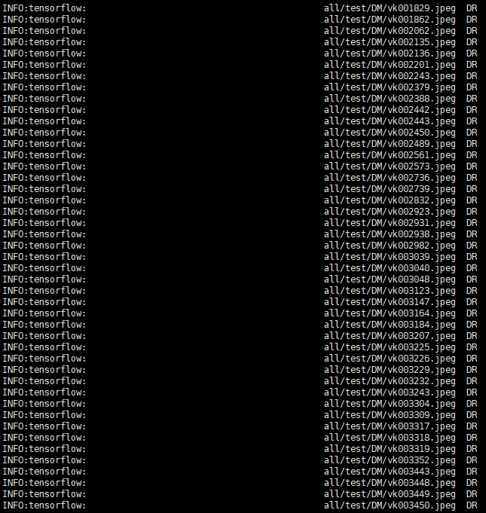
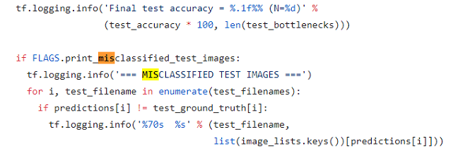
Mis-Classification Analysis
1. Some of the images is too dark (DR->DM)
DR mis-classify to DM: 342 / 525
DM mis-classify to DR: 151 / 1681

Slide 12
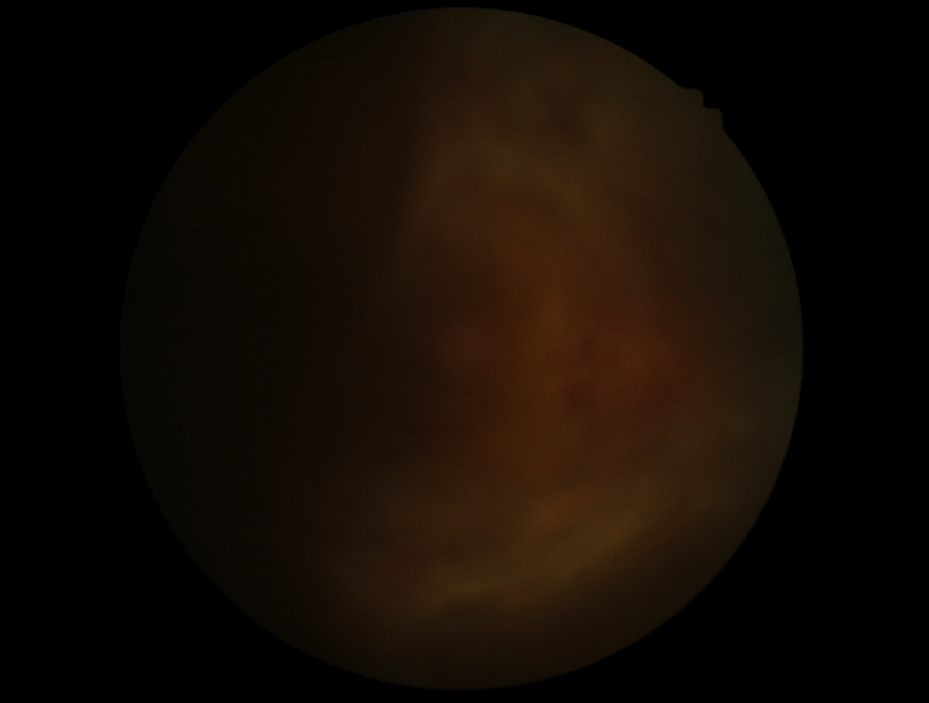
Mis-Classification Analysis
1. Some of the images are too dark (DR->DM)

Slide 13
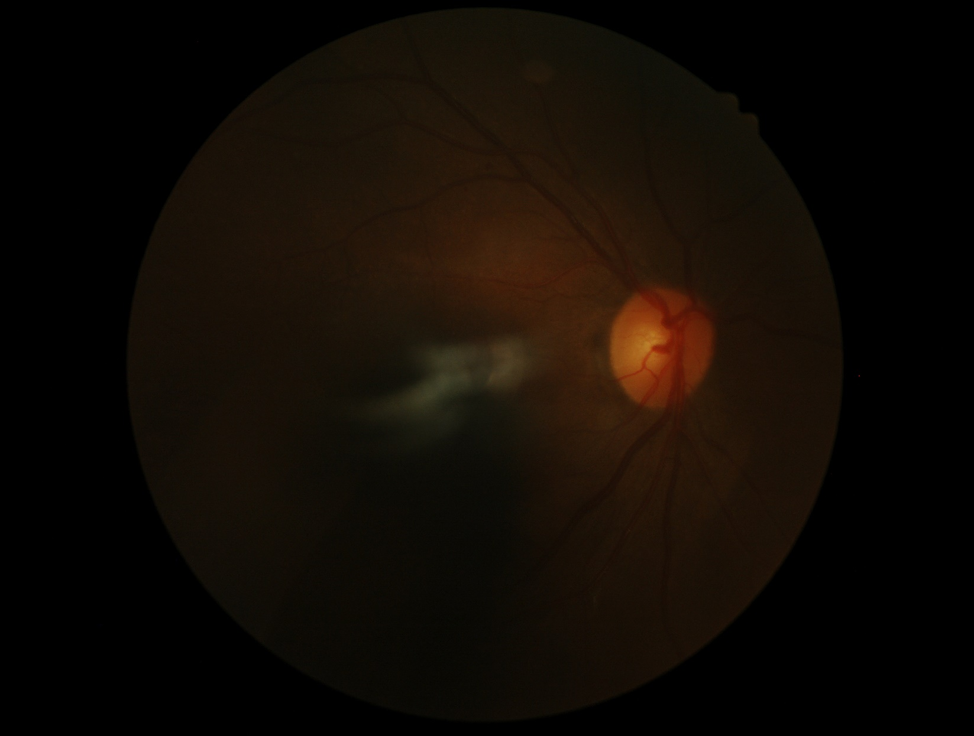
Mis-Classification Analysis
1. Some of the images are too dark (DR->DM)

Slide 14
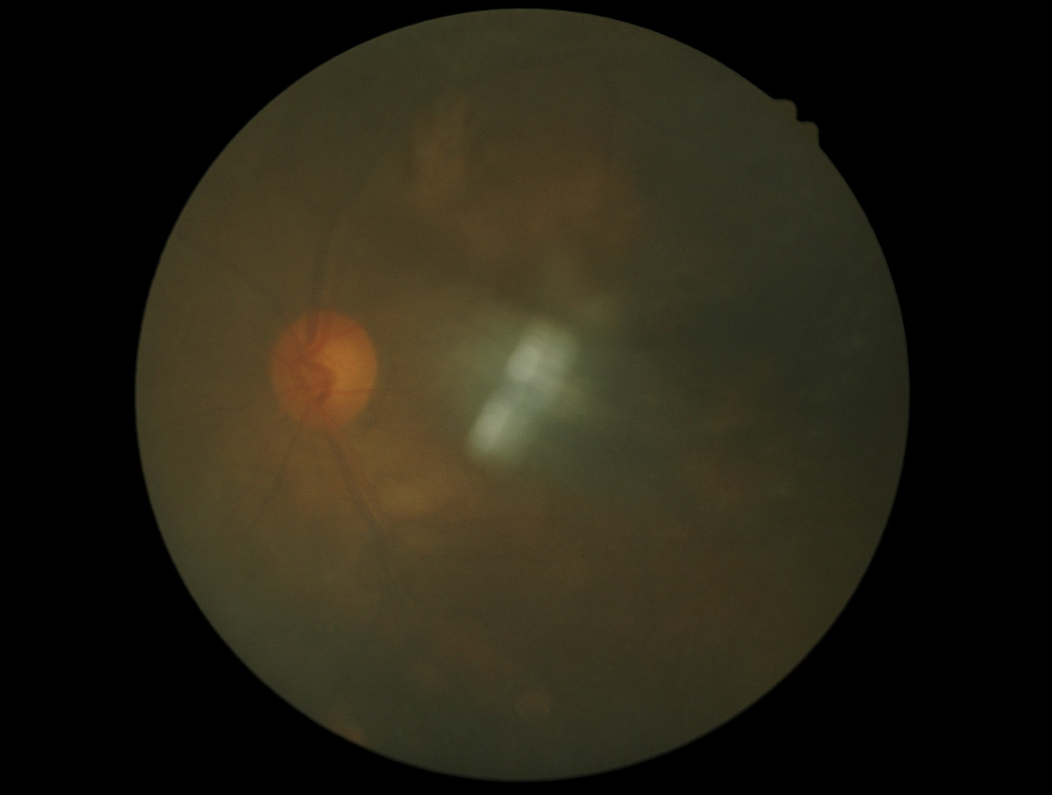
Mis-Classification Analysis
1. Some of the images are too dark (DM->DR)

Slide 15
Mis-Classification Analysis
1. Some of the images are too dark (DM->DR)

Slide 16
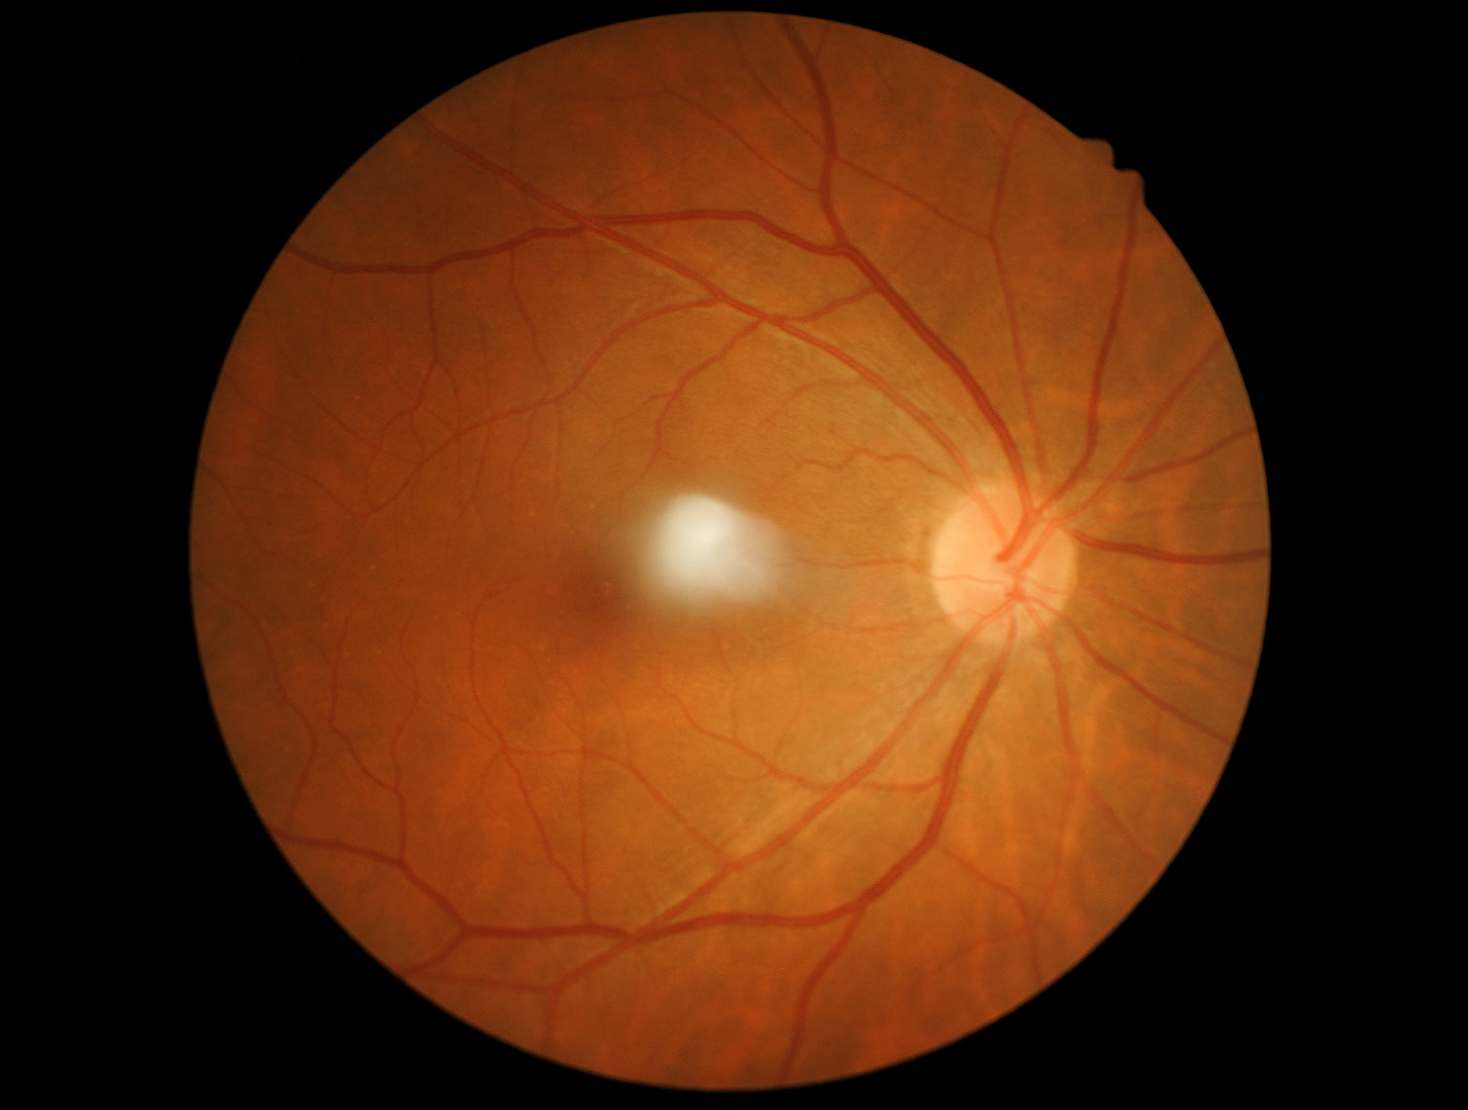
Mis-Classification Analysis
2. Some of the images are few (DM->DR)

Slide 17
Study
Part Three
03

Slide 18
Future plan
01
Analyze the reasons & find questions
02
Try the methods
02
Study

Slide 19
THANKS
And Your Slogan Here.

